Slide 1
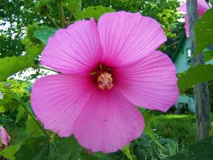
W
E
L
C
O
M
E

Slide 2
Note for the honourable teachers:
The subject teachers are requested to read the notes given below the slides.
Notes are given bellow the slide no. 11 and 13 .
Note for the honourable teachers:
This content may be too long as lesson’s activities are many. If it is too long, it can be taken in two periods.

Slide 3
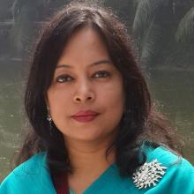
INTRODUCTION
ROUFUN NAHAR
ASSISTANT TEACHER ( ENGLISH)
MAZIDA GOVT. HIGH SCHOOL
TONGI, GAZIPUR
CLASS: SIX
SUBJECT: ENGLISH SECOND PAPER
UNIT: ONE
LESSON: THIRTEEN
TOPIC: PARTS OF SPEECH (Adjective)

Slide 4
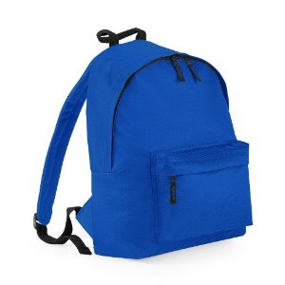
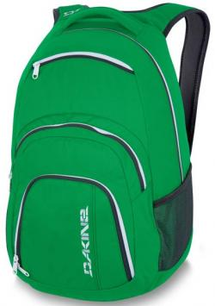


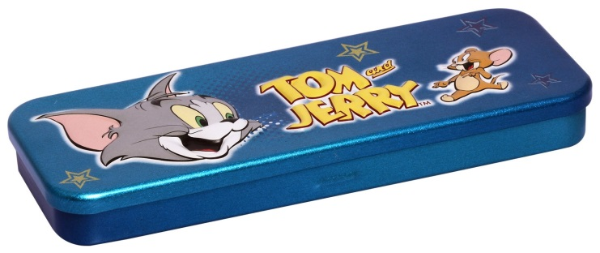

How are the things? Look at the pictures and take words from the box and describe them.
blue
green
two
…………bag
…………bag
…………pencils
three
small
big
…………pens
………..box
………..box
three
green
big
blue
small
two
red

Slide 5
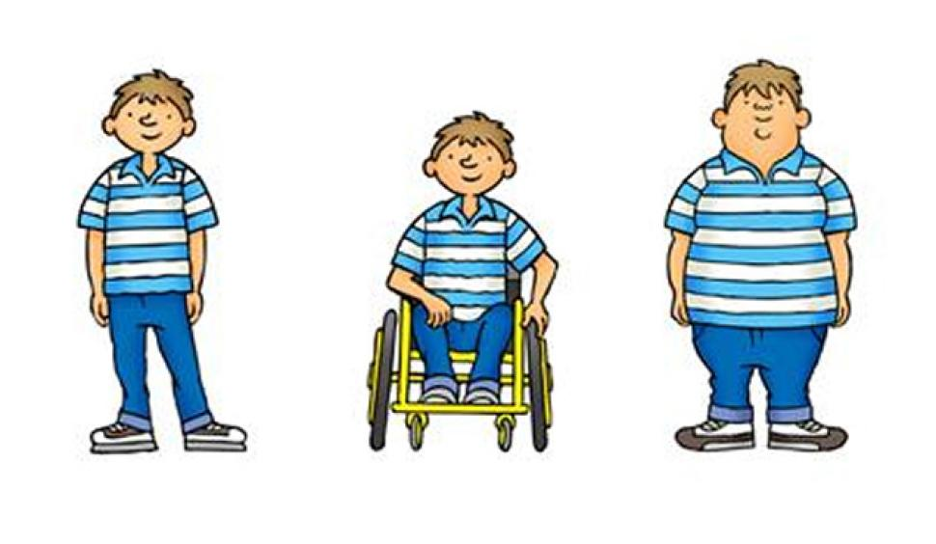
How are the boys? Look at the pictures and take words from the box and describe them.
tall
short
fat
…………boy
…………boy
…………boy
short
tall
fat

Slide 6
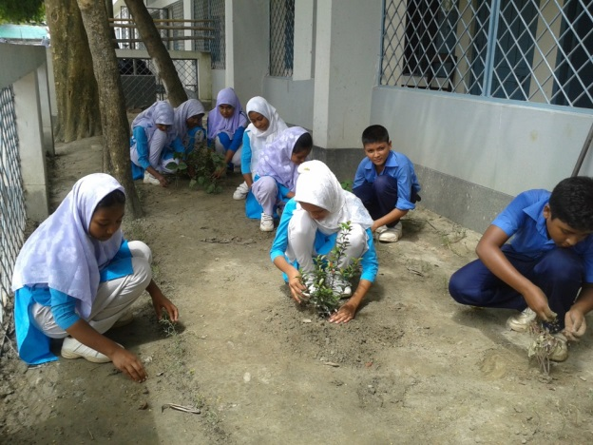

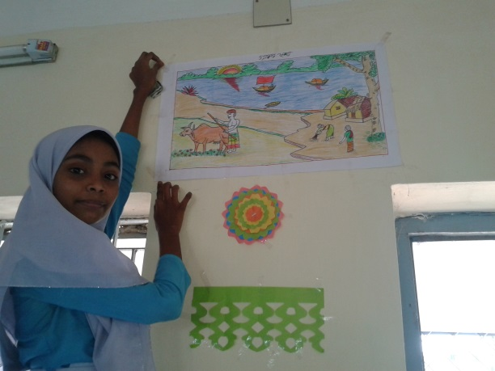
How are the persons and place? Look at the pictures and take words from the box and describe them.
active
attentive
decorative
…………students
...…………girls
……….…….classroom
decorative
active
attentive

Slide 7

What is adjective?
boy
tall
small
box
three
pens
attentive
girls
Adjective is a word that describes or clarifies a noun.
Adjectives describe nouns by giving some information about its size, shape, age, color, origin, material or number (quality or number).

Slide 8
Today our topic is
small
Adjective
big
beautiful
active

Slide 9
LEARNING OUTCOMES OF THE LESSON
By the end of the lesson the students will be able to
identify adjectives.
match adjectives with nouns.
mention some adjectives.
describe an animal using adjectives.
write about oneself using adjectives.

Slide 10
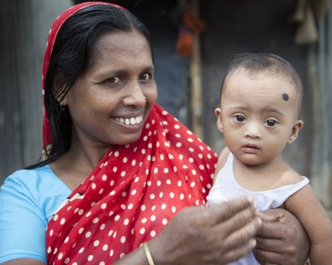
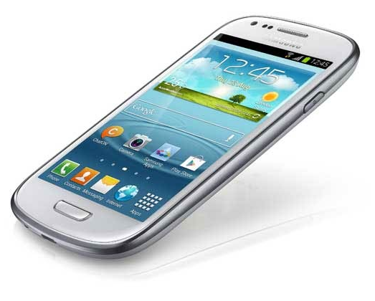
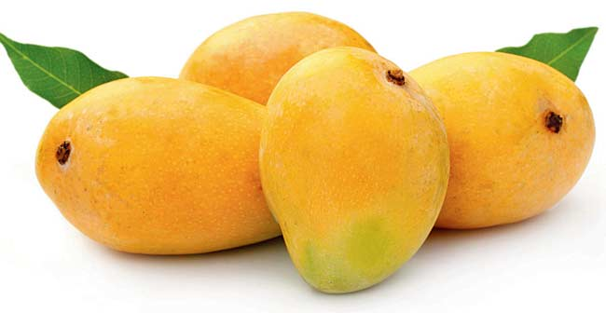
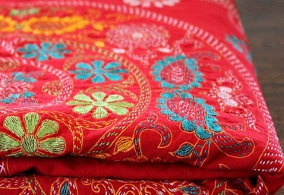
Look at the pictures and match the adjectives with the nouns.
embroidered
mother
happy
phone
smart
mangoes
four
Note: Adjective is used before noun.
quilt

Slide 11
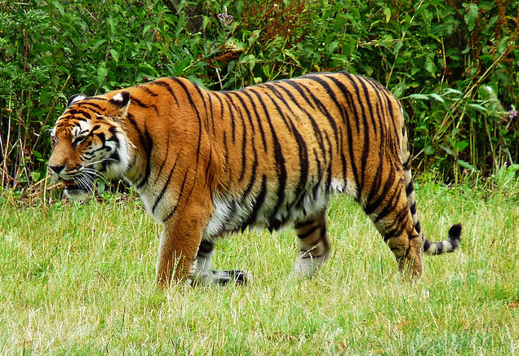
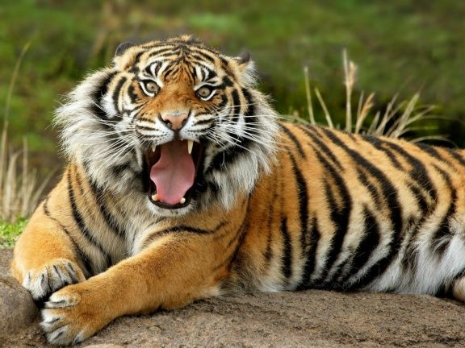
Look at the pictures and describe the words(nouns) with some adjectives.
…………Royal Bengal Tiger
…………body
…………legs
.…………tail
.………claws
…………teeth
Notes:
Teacher may ask the students to raise their hands or ask randomly the answers.

Slide 12

Read the sentences about a rose and say the adjectives filling the gaps with the letters.(for each dash one letter)
1. The rose looks be_ _ti_ _l.
a
u
f
u
2. It is r _ d.
e
3. It is ch _ r _ _ng too.
a
m
i
e
4. It smells sw_ _t.
e
p
p
5. I feel ha_ _y when I see a rose.
6. I become a_ra_d of touching it if there is thorns with it.
f
i
Note: Adjective is also used after some linking words such as-am/is/are/was/were/feel/become/seem/smell/taste/get.

Slide 13
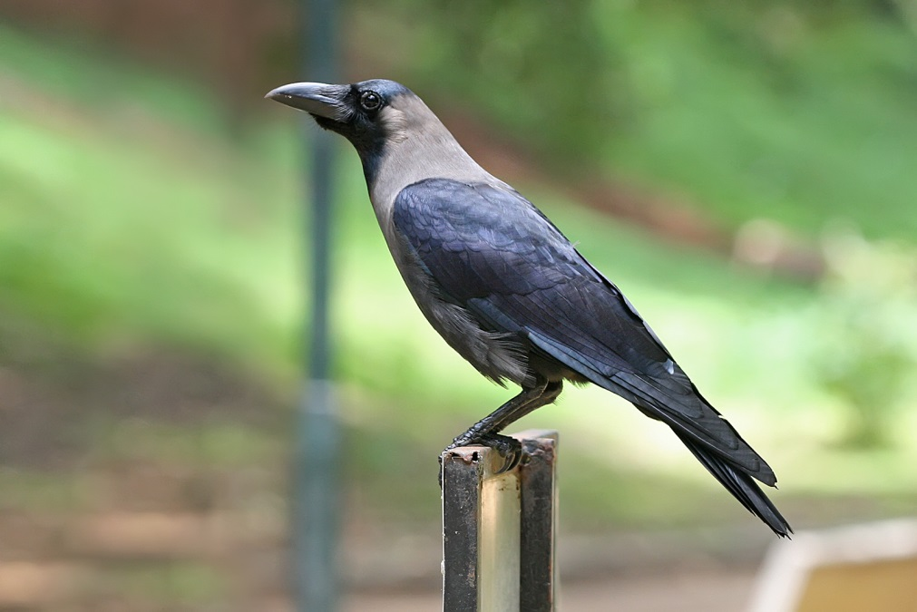
Talk to your friends about the crow using some adjectives. (Clues are given below.)
How it looks, body, eyes, beck, legs, claws, wings
Notes:
Teacher may give three minutes to talk about the crow. After that teacher may ask few students randomly to say about the crow.

Slide 14
Pair work
Read the following passage and find out the adjectives from it.
Anik Islam is a good student. He is also intelligent. His school is Mozida Govt. High School. It is a big school. He sings well. He likes to sing folk song. He also likes to read story book.
good
intelligent
big
folk
story
Answer

Slide 15
Individual work
Write about yourself using some adjectives and underline the adjectives. (Not more than 8 lines)

Slide 16
Home work
Write about your parents using adjectives and underline the adjectives. (Not more than 15 lines)

Slide 17
Acknowledgement
MoE, DSHE, NCTB & A2I respective of officials
And the editors panel: Ranjit Poddar, Associate Professor (English) TTC, Dhaka, Md. Jahangir Hasan (English), Assistant Professor TTC, Rangpur and Urmila Khaled Assistant Professor (English) TTC, Dhaka.
Their direction, valuable suggestions and intensive supervision have enriched the model contents.

Slide 18

THANK YOU ALL

